Slide 1
Home Credit Default Risk
Professor Gregory Rawlins
Shashank Mittal
Raja Rajeshwari Premkumar
Utsav Patel

Slide 2
Exploratory Data Analysis
Imbalance
Anomalies
Categorical features encoding
Missing values imputation
Normalization
Aggregation

Slide 3
Imputation Method used:
Our approach for Imputing values in app_train goes this way:
Total cols : 122
76 columns were having min 0 and max 1 (these were mixed of type float and int )
used Mode Imputation
Rest 46 columns:
16 categorical:
No Missing values, directly did pd.get_dummies()
30 continuous:
Type:1 continuous values with digits after decimal point and widely distributed
Did Mean Imputation
Type:2 Values in some range (1,2...NA,...21),(1,2,3....NA.10).
Treated them as classes and did Mode Imputation

Slide 4
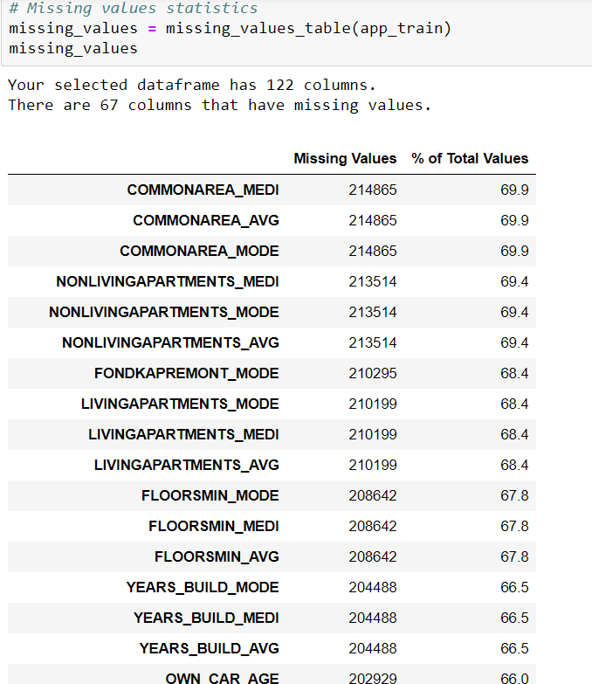
Approach to combine all 7 tables : Major Issue?

Slide 5
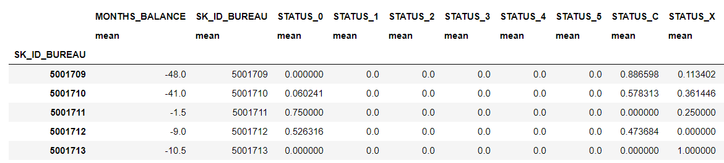
Adding useful features
Self created Features landed up in top 50 features of total 798 features.
Using Mean for person’s entries:
grouping by SK_ID_BUREAU and then found mean and entered as a column in separate dataframe that is used later

Slide 6
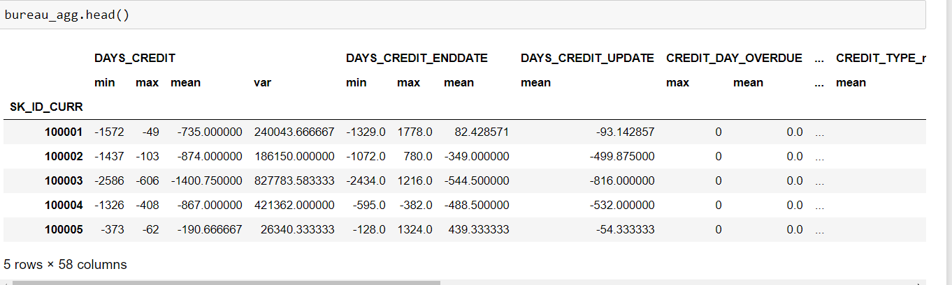
Min mean max var:
for some tables , we found the mean, minimum, maximum and variance of columns of ID’s by grouping them by SK_ID_CURR

Slide 7
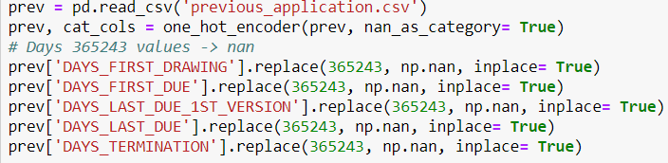
Replacing anomalies:

Slide 8
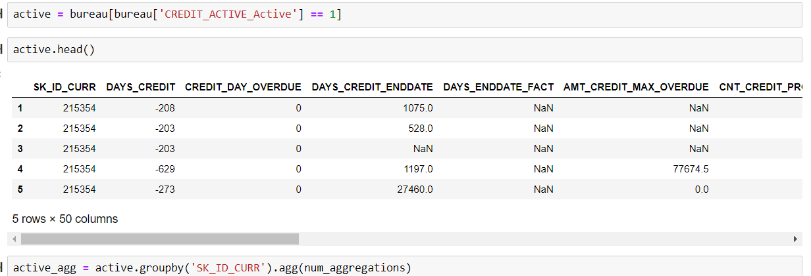
Using Credit Active and Credit Inactive column

Slide 9
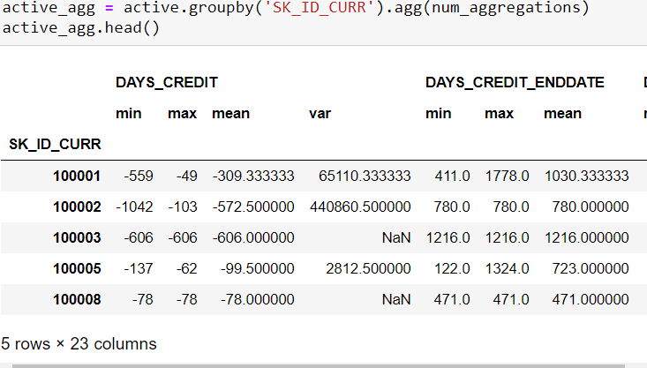

Slide 10
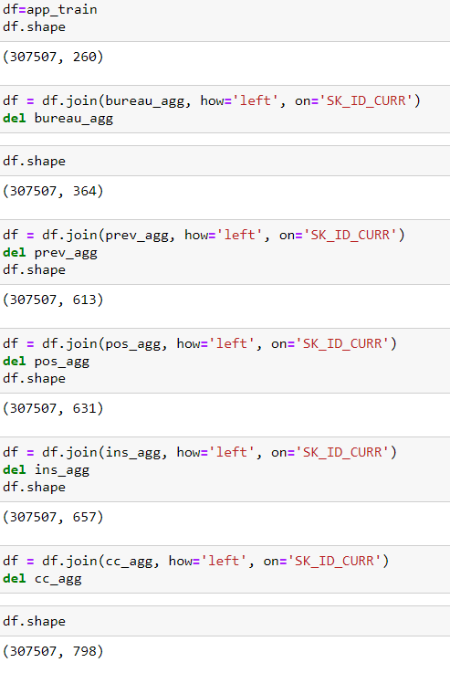

Slide 11
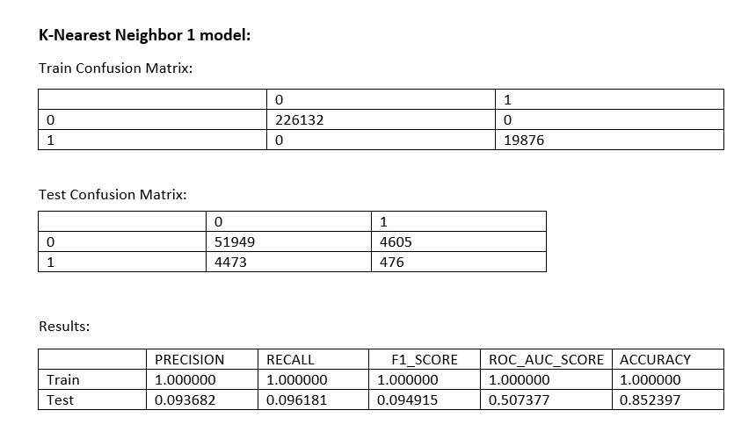
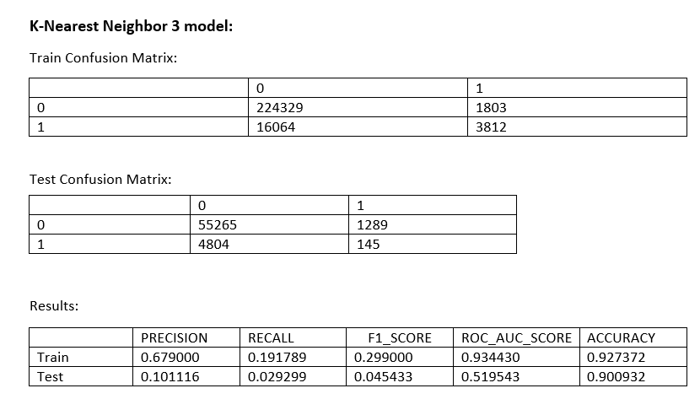
Missing Value
1st Method-
Replaced every missing cell with -999

Slide 12
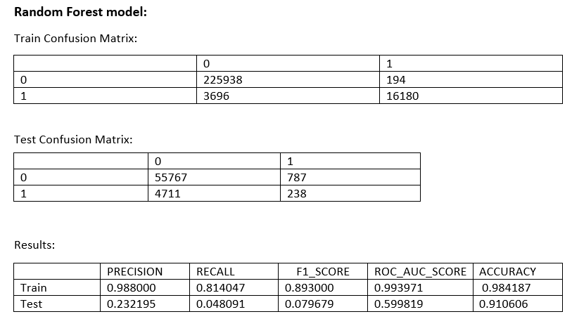
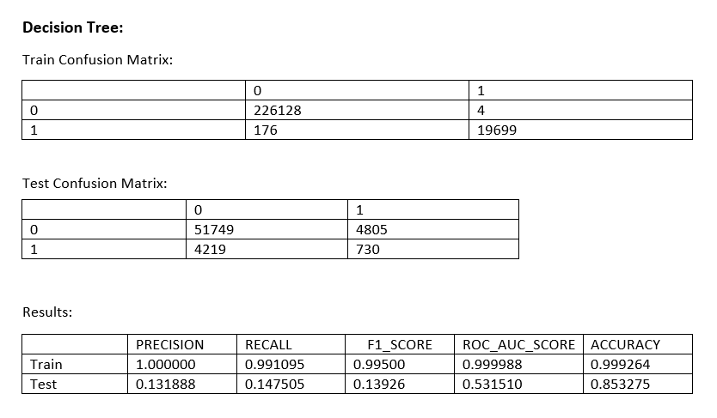

Slide 13
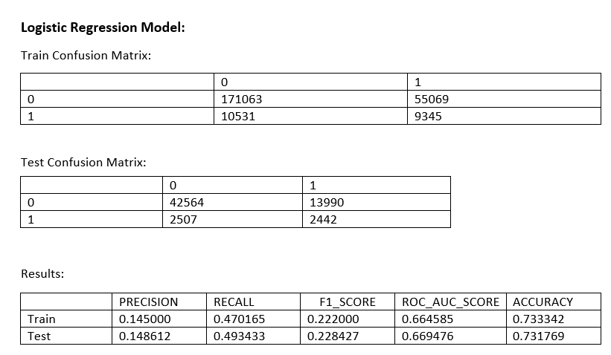

Slide 14
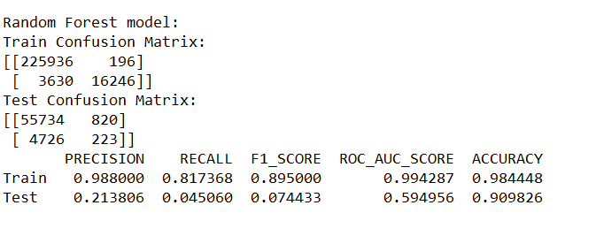
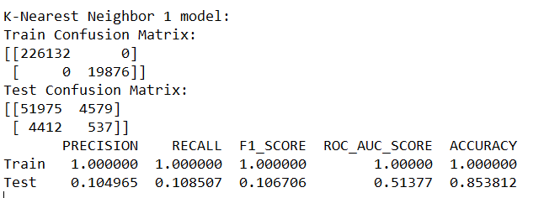
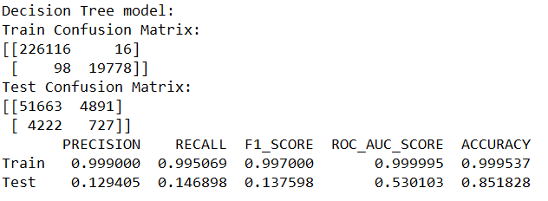
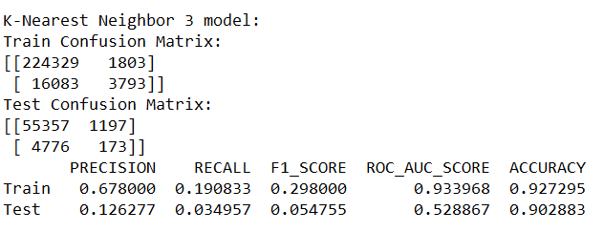
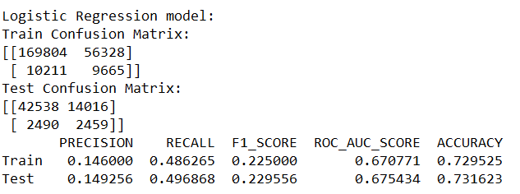
Replaced every missing cell with -999 with aggregation

Slide 15
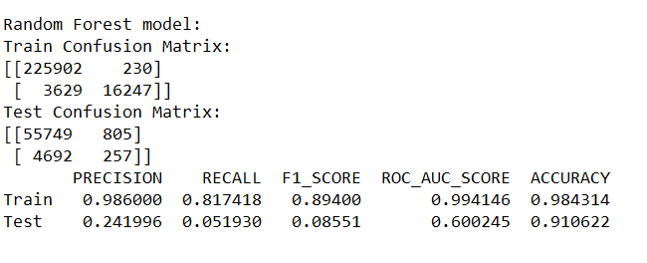
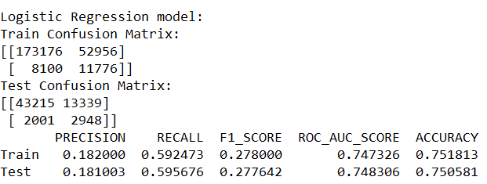
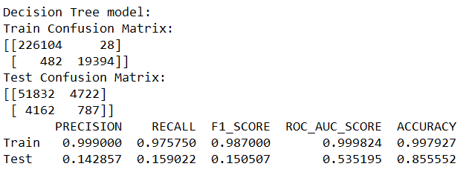
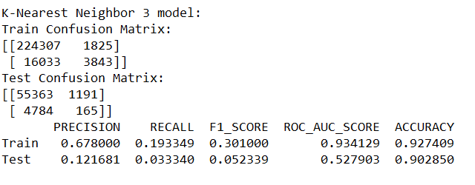
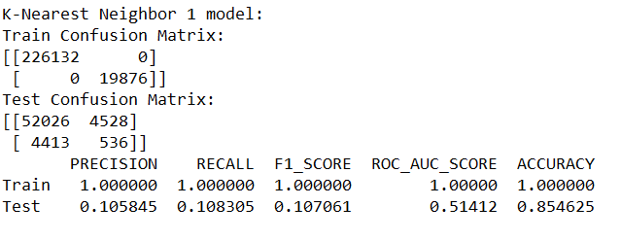
Mean Mode approach 1

Slide 16
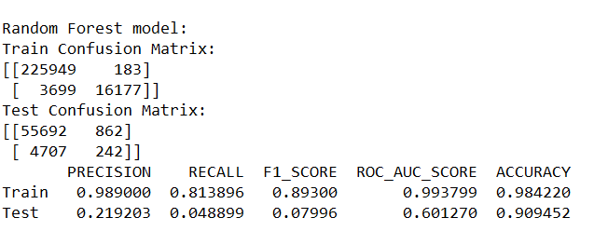
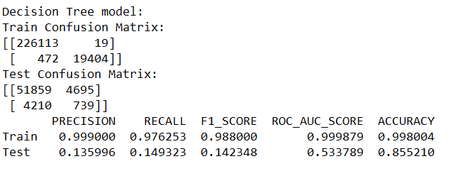
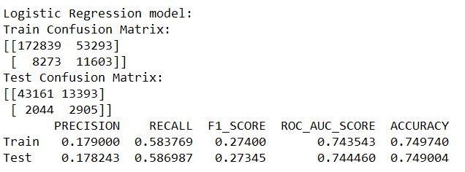
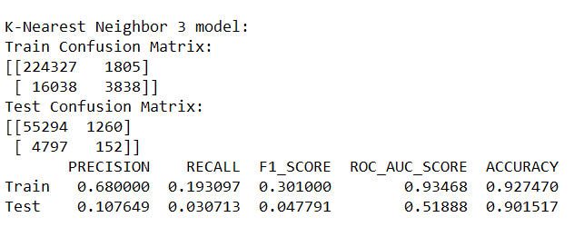
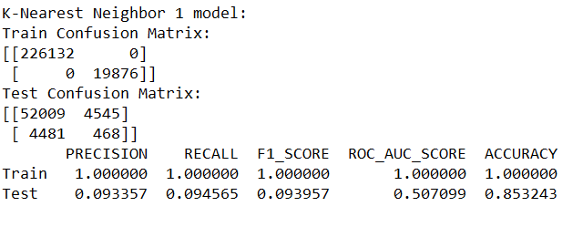
Mean Mode Approach part 1 with aggregation

Slide 17
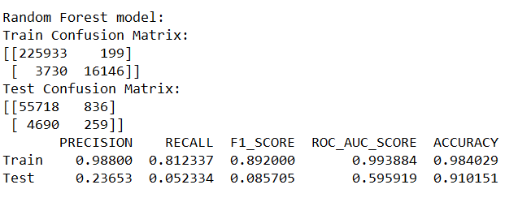
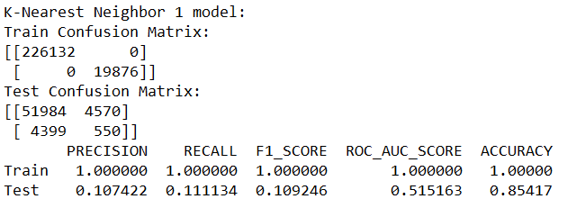
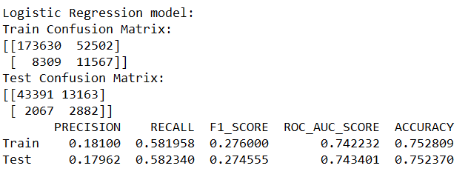
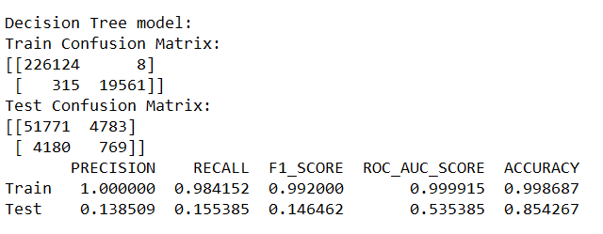
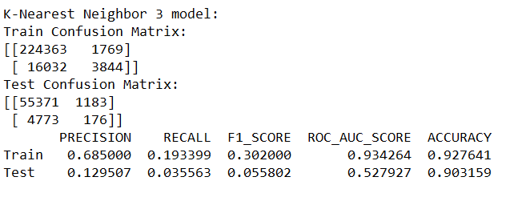
Mean mode approach part2

Slide 18
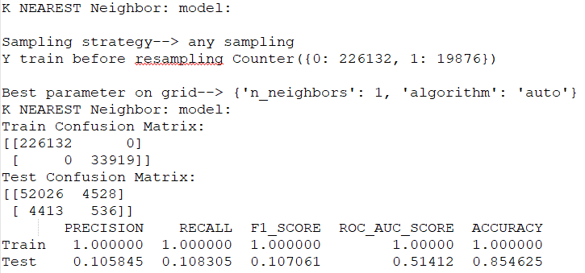
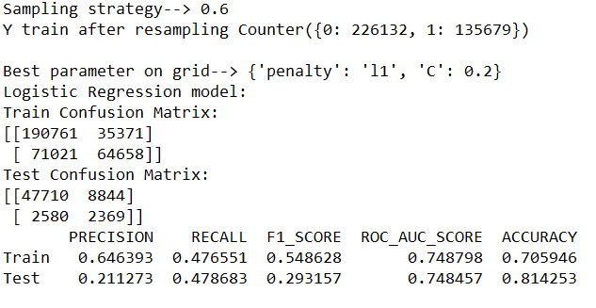
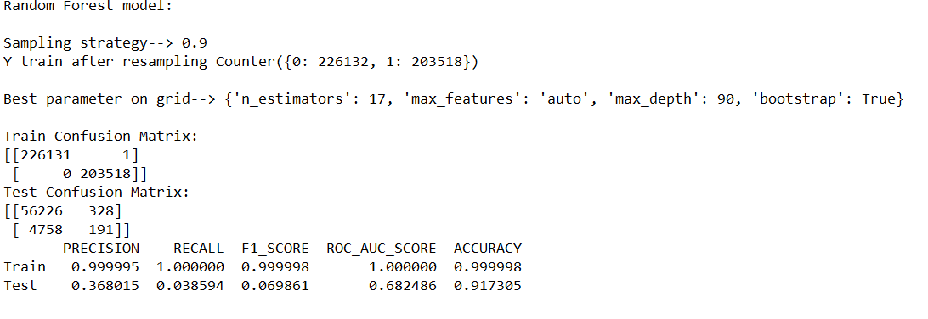
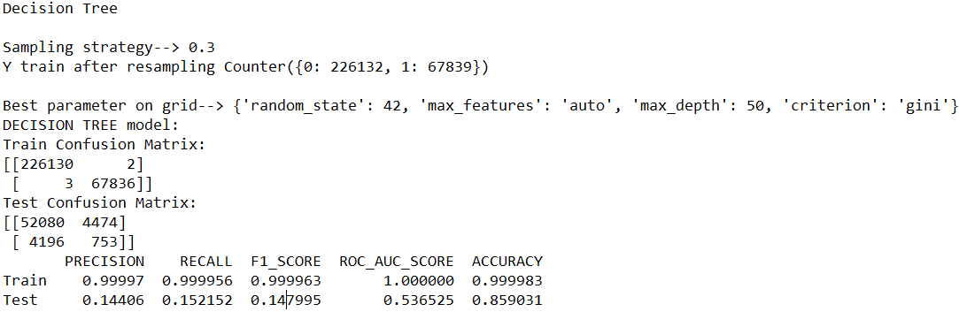
Imbalance over sampling

Slide 19
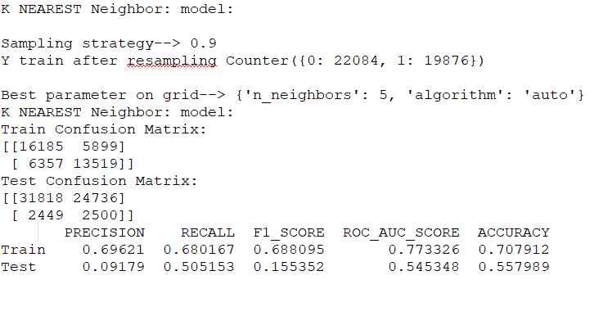
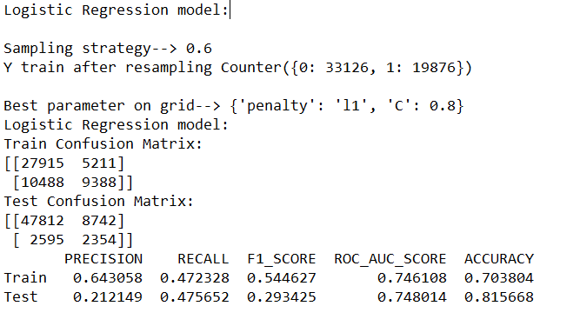
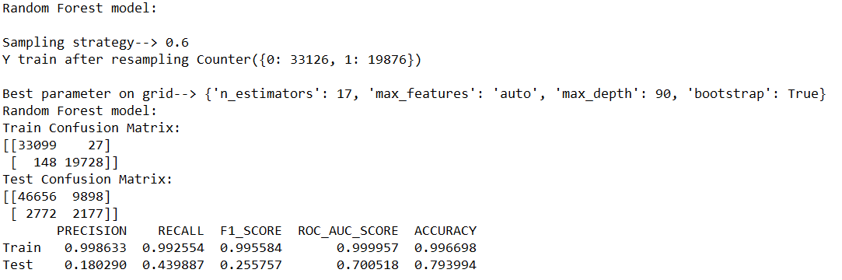
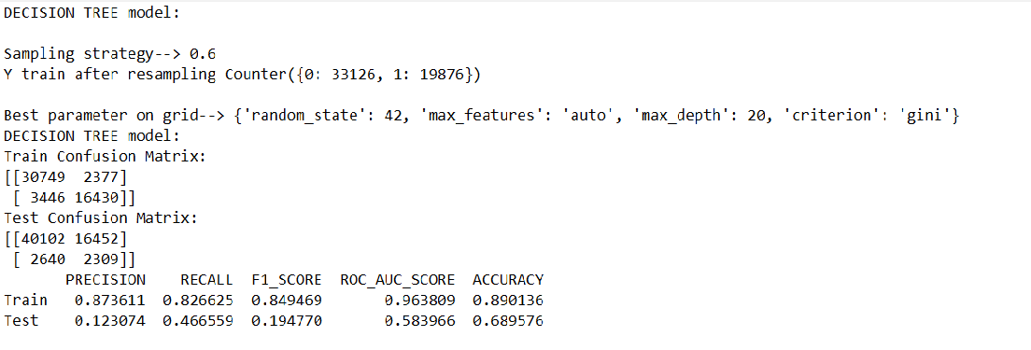
Imbalance under sampling

Slide 20
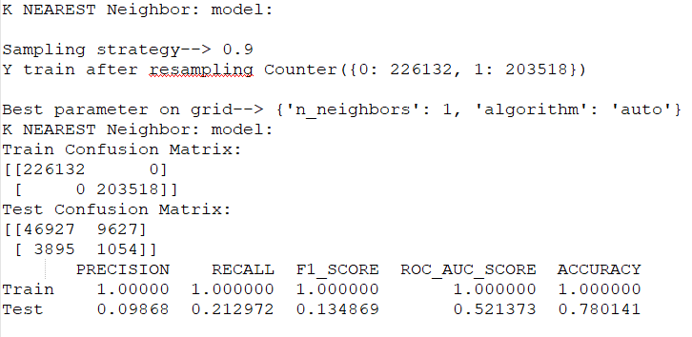
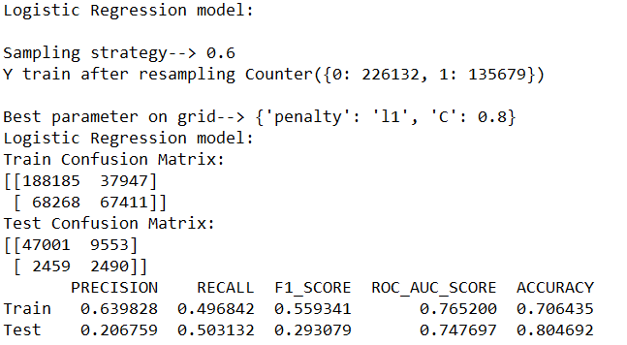
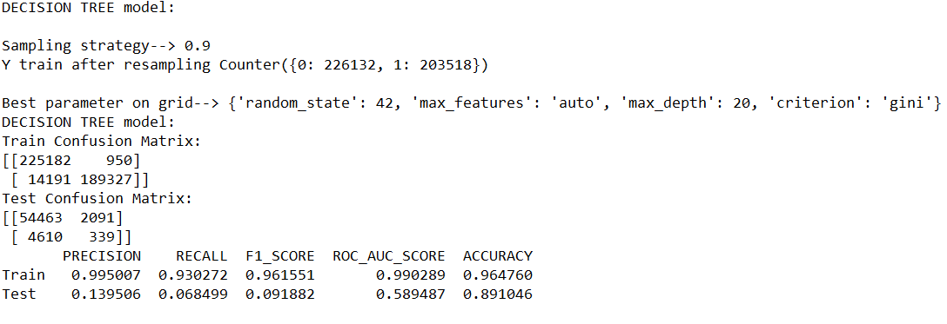
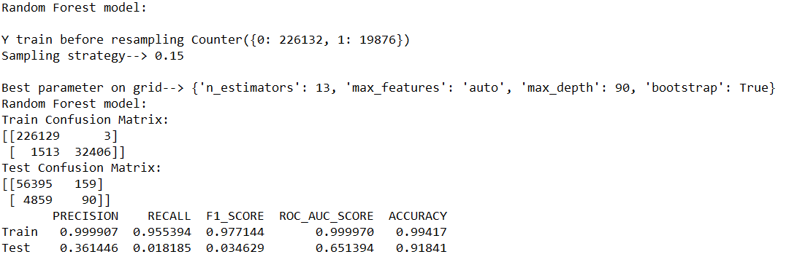
Imbalance smote

Slide 21
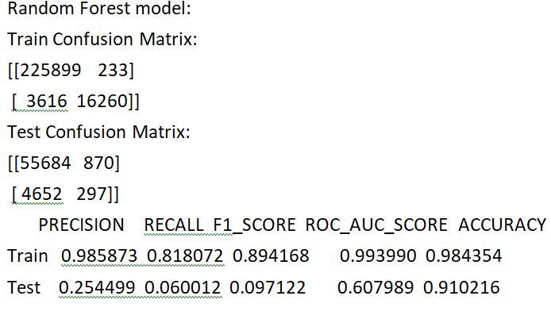
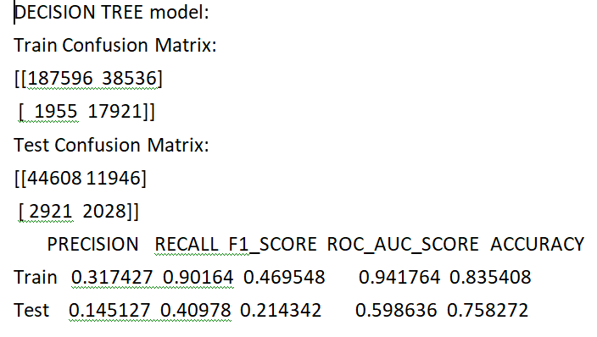
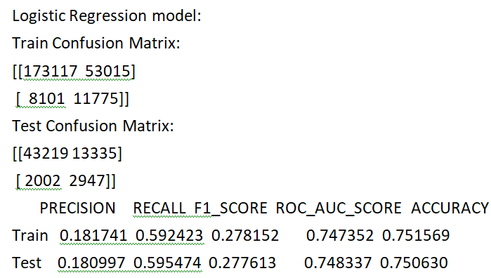
Imbalance Cost based approach

Slide 22
XGBoost
Why XGBoost?
Regularization
Parallel Processing
High Flexibility
Handling Missing Values
Tree Pruning
Built In Cross Validation

Slide 23
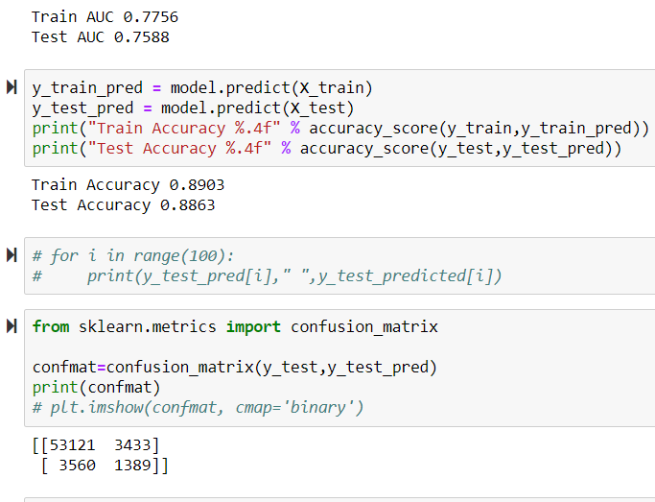
What we tried for XGBoost?
1. XGBoost model on application_train.csv
Manual feature engineering
Parameter Tuning

Slide 24
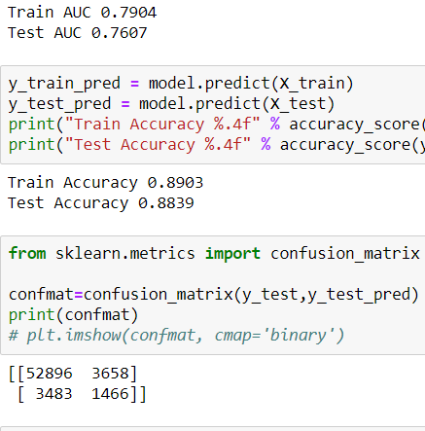
2. XGBoost model on application_train.csv + Dropping top 15 missing columns
Manual feature engineering
Parameter Tuning
Dropping Most 15 missing columns in efficient manner

Slide 25
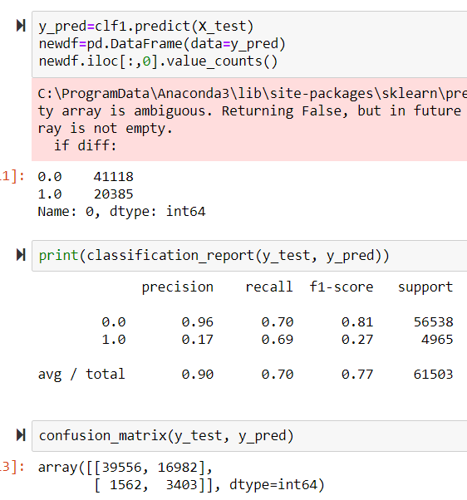
3. XGBoost on application_train_imputed.csv:
application_train_imputed.csv had no null values
Parameter Tuning

Slide 26

4. XGBoost on application_train_imputed.csv + SMOTE:
SMOTE is a technique used to oversample the data label that is very few. We tried to oversample the data label that is much less ie. People who will default.

Slide 27

5.XGBOOST on all 7 tables combined (FINALHOMECREDIT.csv):
The data file that we prepared by combining all 7 tables was used here. It was having shape of (307507,798). This data file was providing test AUC of 0.7817
detected almost 1600 defaulters

Slide 28
What Worked?
Using FINALHOMECREDIT.csv table worked for us as it was made up with all 7 tables. What didn’t work?
What did not work?
SMOTE
Compared to SMOTE-results : detecting almost 71% of people who will default, the results of XGBoost in 5th model (on FINALHOMECREDIT.csv) is a lot better which is just detecting 30% of people who are defaulters because SMOTE misclassifies 34% of nondefaulters (19000 people), while our 5th model misclassifies only 5%(3,000) of people who are nondefaulters.
What could be done in future?
Neural Networks and CatBoost
Ensembling of XGBoost, LightGbm and Neural Networks
Powerful GPU – Better Parameter Tuning

Slide 29
LightGbm Classifier:
Why LightGbm?
Light GBM grows tree vertically- grows leaf wise instead of level wise
When growing the same leaf, Leaf-wise algorithm can reduce more loss than a level-wise algorithm.
We preferred LightGBm to run because:
Works well on Large size of data
Lower memory to run
LightGbm supports GPU Learning

Slide 30

What all we tried for LightGbm? 1. LightGbm on application_train_imputed.csv file:

Slide 31

2. LightGbm on application_train_imputed.csv file + SMOTE:

Slide 32

3. LightGbm on all 7 table combined file (FINALHOMECREDIT.csv):
The data file that we prepared by combining all 7 tables was used here. It was having shape of (307507,798).

Slide 33

4.LightGbm on all 7 tables combined file + parameter tuning:
K Fold CV for a shape of almost 300000.
estimators -10000
AUC metric of 0.7861 which was a lot better than other models that we performed.

Slide 34


Slide 35


Slide 36
What Worked?
Not misclassifying the nondefaulters.
The AUC metric for 4th model was the best one and it worked well. We received a metric of 0.7886 while Kaggle top scorer got 0.80.
What did not work?
SMOTE
The results that we achieve with SMOTE are really bad in both XGboost and LightGbm.
Detecting the number of more.
What could be done in future?
Ensemble Modeling of multiple LightGbm’s.
Ensemble of LightGbm with other models.
More parameter tuning with the model building phase.

Slide 37
THANK YOU

